Slide 1
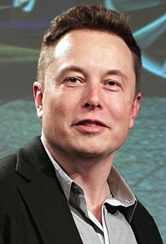
Elon Musk

Slide 2
WHO IS ELON MUSK?

Slide 3
Elon Reeve Musk (born June 28, 1971) is a South African-born Canadian American business magnate, investor, engineer and inventor.
Elon Musk is known for his futuristic ideas.
Numerous passions inspired Musk, and today he manages companies and projects that specialize in electric and self-driving cars, private space exploration and Mars colonization, solar energy and artificial intelligence.

Slide 4
CAREER
Zip 2 (1995)
X.com (1999) and PayPal
SpaceX (2002)
Tesla (2003)
SolarCity(2016)
Hyperloop
OpenAI
Neuralink
The Boring Company

Slide 5
The Boring Company

Slide 6
What is this?
The Boring Company (TBC) is an infrastructure and tunnel construction company founded by Elon Musk in late 2016.
To alleviate traffic, transportation corridors.
There is no practical limit to how many layers of tunnels can be built, so any level of traffic can be addressed.
Tunnels are weatherproof.
Tunnel construction and operation are silent and invisible to anyone on the surface.
Tunnels don’t divide communities with lanes and barriers.
Why tunnels?

Slide 7
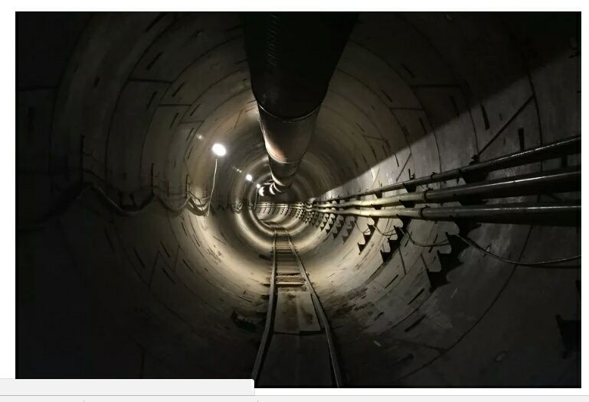
Musk has picked LA as the testing ground both because he works in nearby Hawthorne and because the city’s notorious traffic jams gives the Boring Company a clear-sighted target.

Slide 8
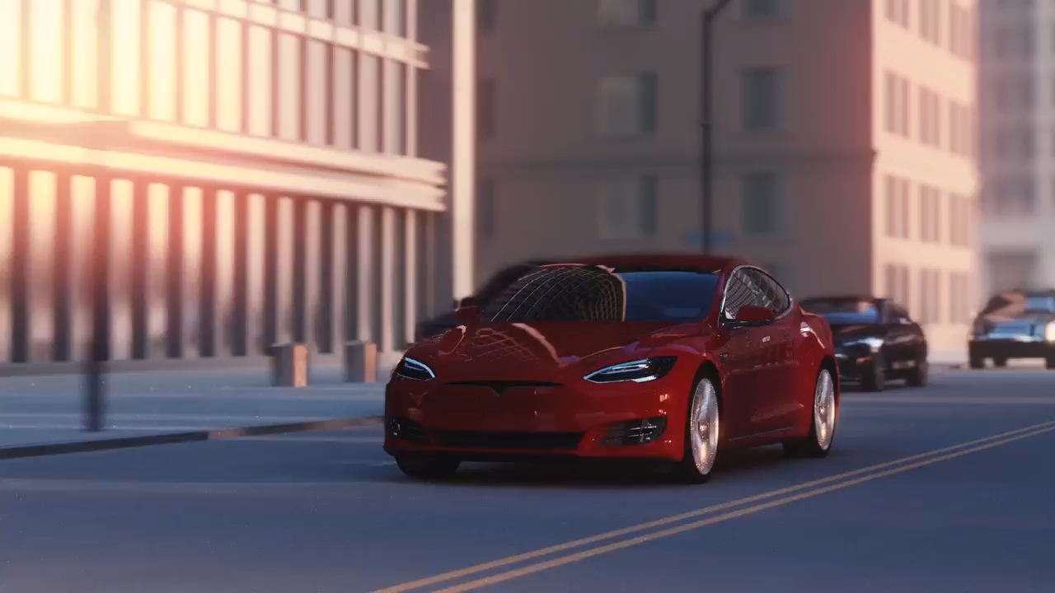
The Boring Company | Tunnels

Slide 9
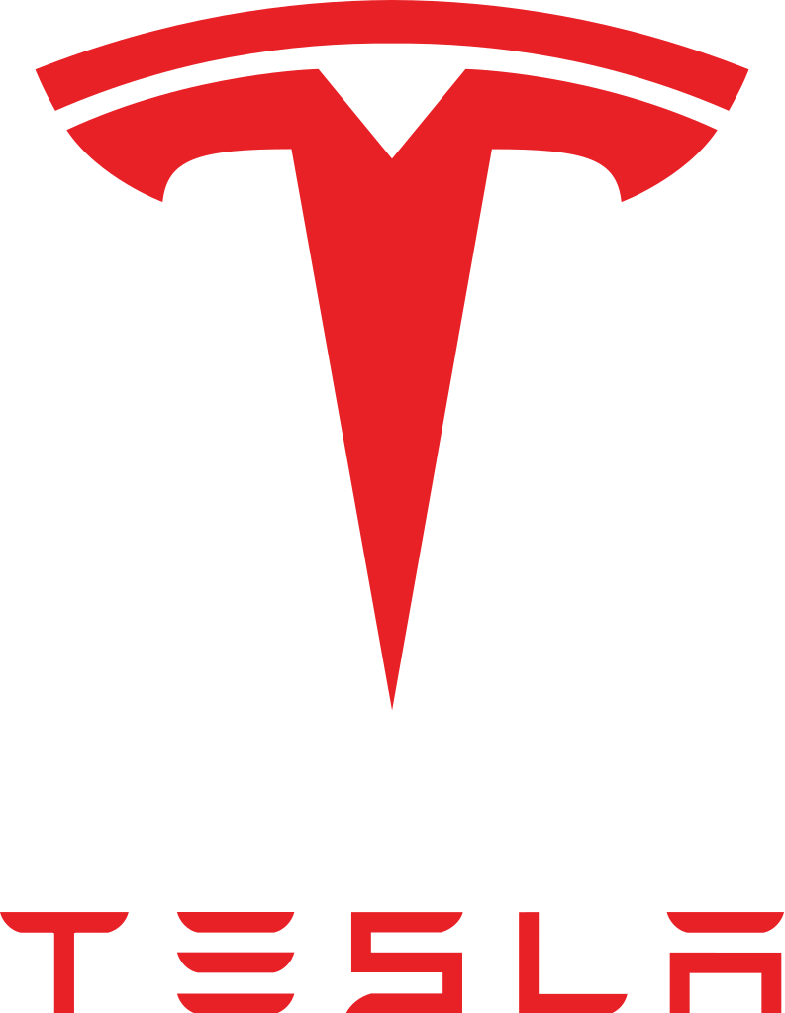
Tesla
“Sustainable Transport
electric tehnology”

Slide 10
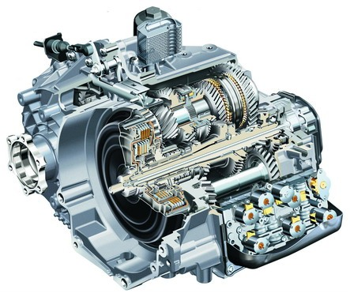
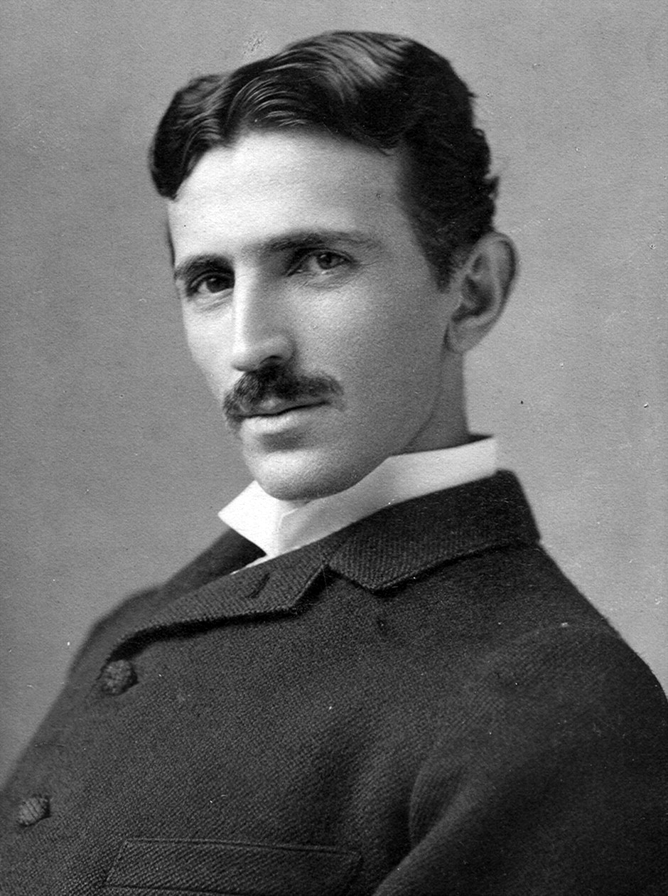
Overview
Tesla is named after the electrical engineer and physicist Nikola Tesla.
Nikola was best known for his contribution to the design of the modern alternating curent (AC) electricity supply system.
Tesla is an American company that designs, manufactures and sell electric cars and electric vehicle powertrain components.

Slide 11
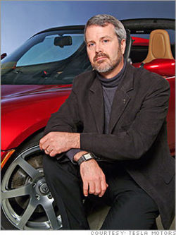
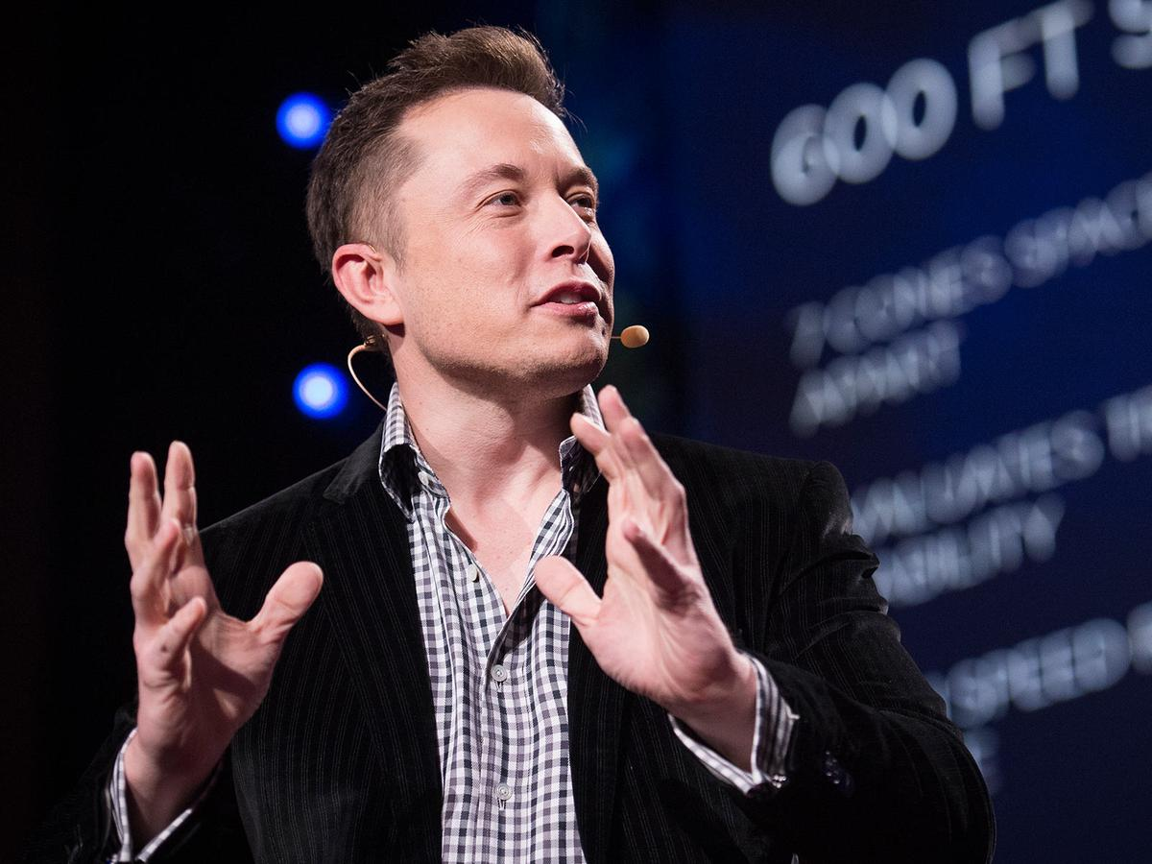
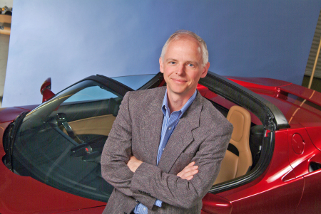
History
Founded in 2003 by Elon Musk, Martin Eberhard, and Marc Tarpenning in Silicon Valley
March 2008 - Tesla begins production of Roadster and sells about 2000 of them.
Jan 2010 - Tesla register for an IPO
May 2010 - Tesla buy former GM factory in Fremont, CA and Toyota signs deal to cooperate in EV development

Slide 12
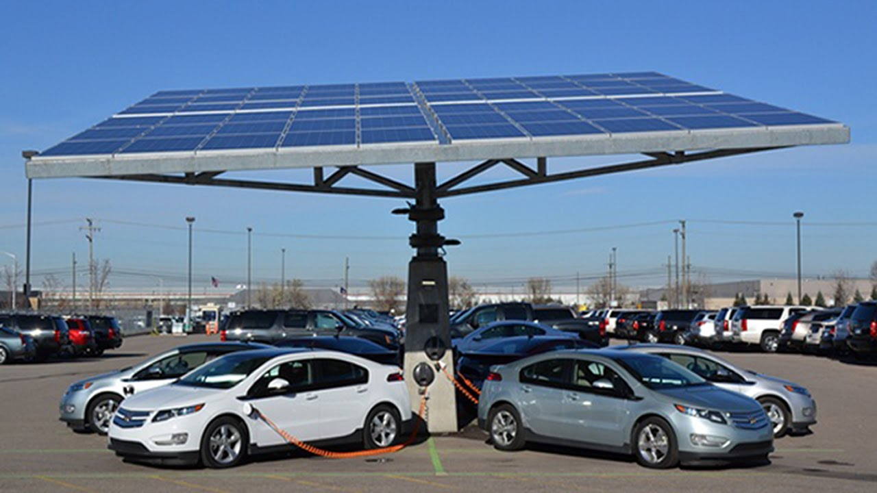
Why Tesla?
Biggest opportunity for growth
Elon Musk’s proven leadership (Paypal and SpaceX)
Appleizing the car industry
New form of selling cars with no dealerships
Prove to transform the market, first to produce electric cars relatively cheaply

Slide 13
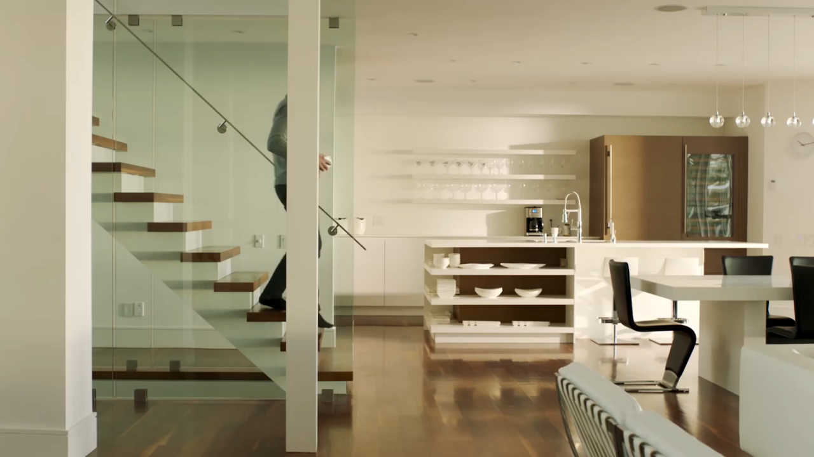

Slide 14

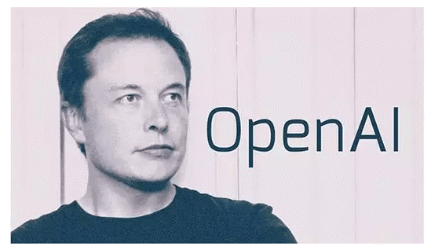

OpenAI is a non-profit research company working to build safe artificial intelligence. 11th December 2015, San Francisco

Slide 15

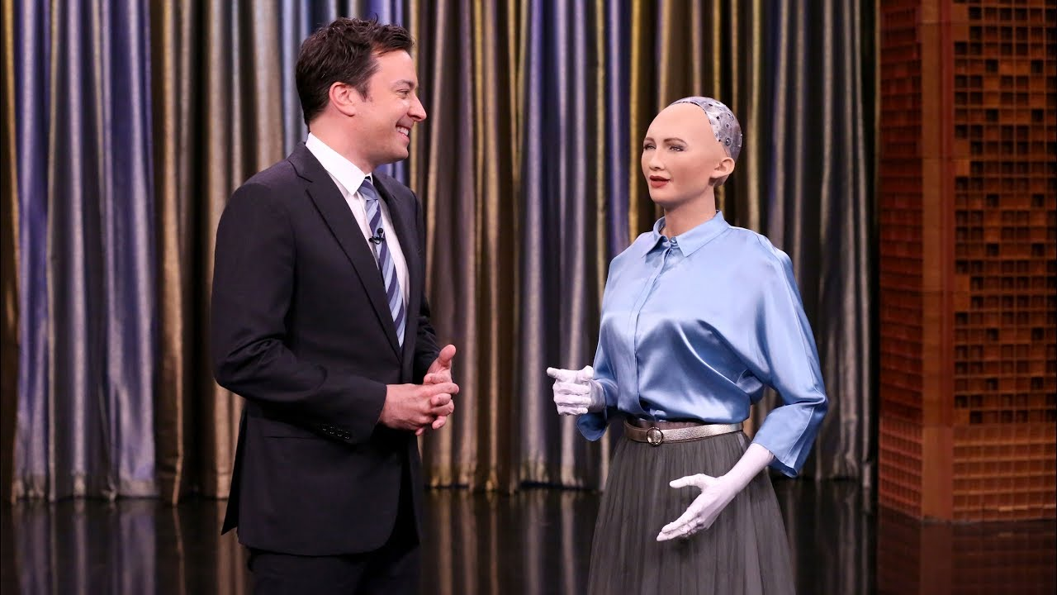
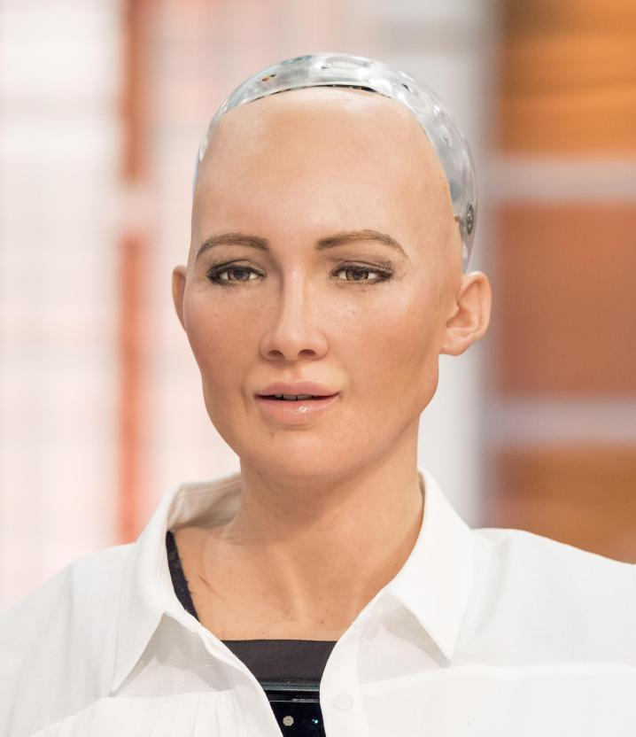
Sophia is a humanoid robot developed by Hong Kong-based company Hanson Robotics.
Elon Musk began warning about the possibility of A.I. behave uncontrollably three years ago.
Mars = a place to escape if A.I. turns against humanity.

Slide 16

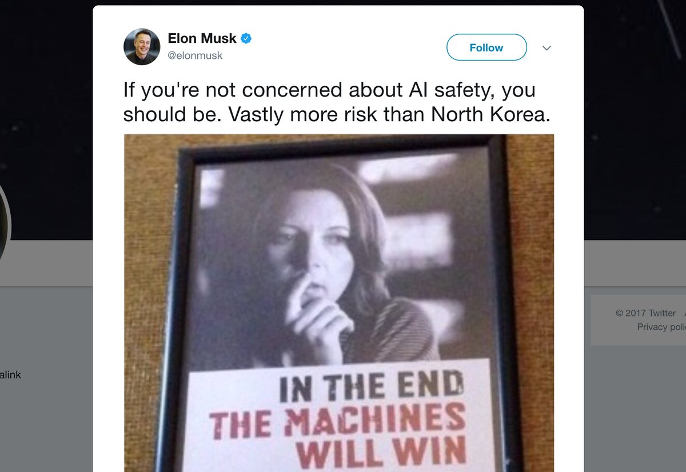
“What will happen is a scientist will get so engrossed in their work that they don’t really realize the ramifications of what they’re doing.”
A.I. is humanity’s “biggest existential threat.”
There should be some national or international regulatory oversight “to make sure that we don’t do something very foolish.”
“With artificial intelligence, we are summoning the demon.”

Slide 17
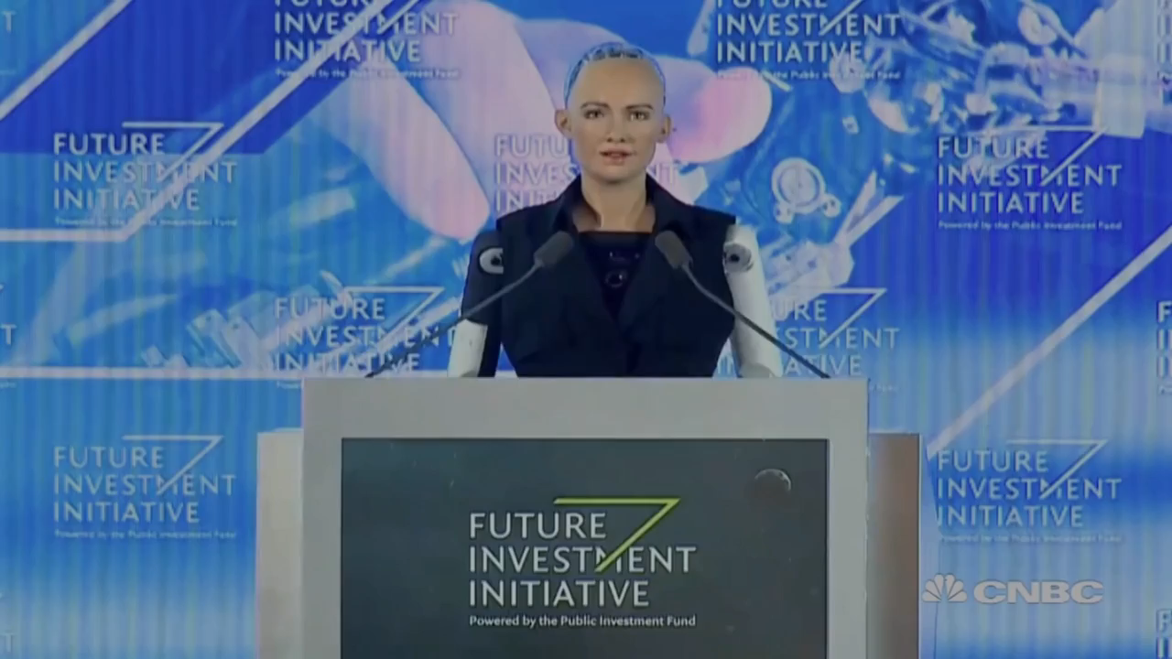

Slide 18
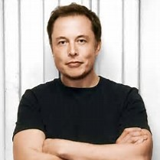
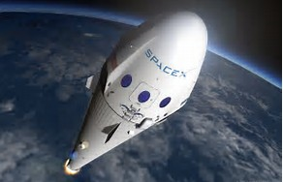
SPACEX

Slide 19
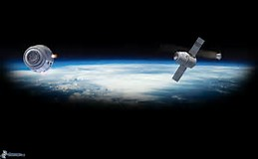
Space Exploration Technologies (SPACEX) is an american aerospace manufacturer and space transport services company.
It was founded in 2002 by entrepreneur Elon Musk with the goal of reducing space transportation costs and enabling the colonization of Mars.
The company has grown rapidly since it was founded, growing from 160 employees in November 2005 to nearly 6,000 employees in April 2017.

Slide 20
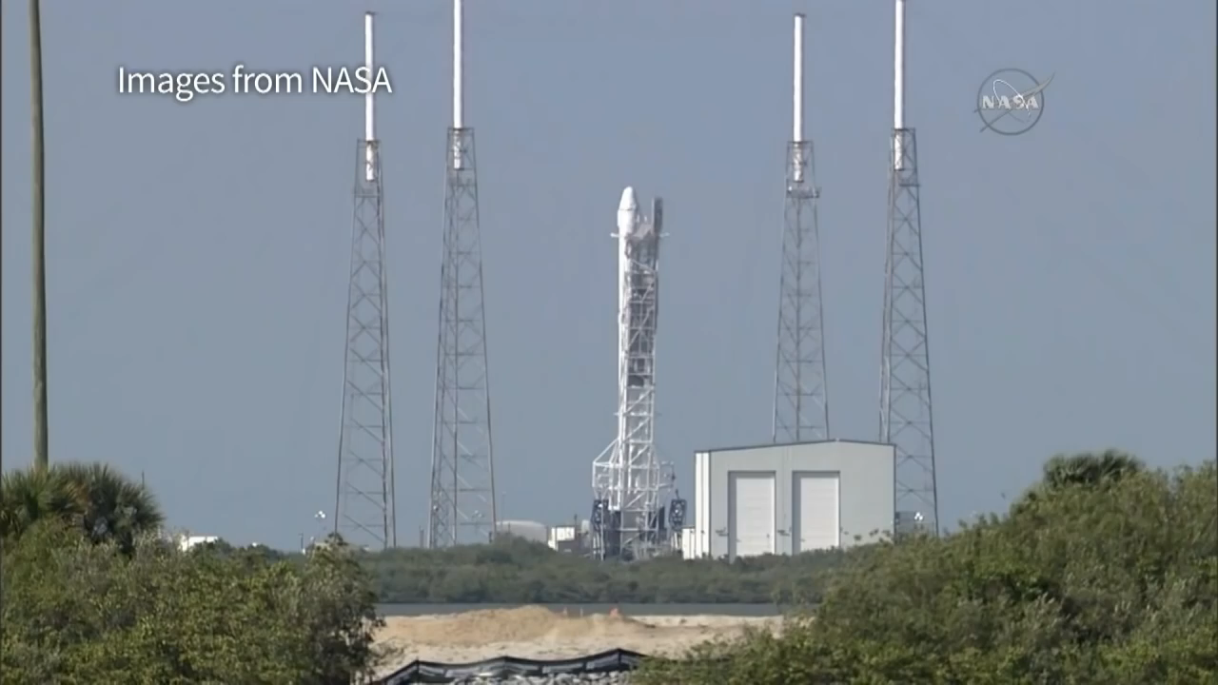
SpaceX started with the smallest useful orbital rocket, instead of building a more complex and riskier launch vehicle, which could have failed and bankrupted the company.
A major goal of SpaceX has been to develop a rapidly reusable launch system.
Landmark achievements of SpaceX include:
The first privately funded liquid-fueled rocket to reach orbit (Falcon 1 Flight 4 — September 28, 2008).
The first privately funded company to successfully launch, orbit, and recover a spacecraft (Falcon 9 Flight 2 — December 9, 2010)
The first private company to send a spacecraft to the International Space Station (Falcon 9 Flight 3 — May 25, 2012)
The first reflight of a commercial cargo spacecraft. (Falcon 9 Flight 35 — June 3, 2017)

Slide 21
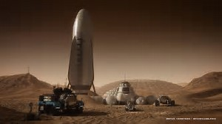
At year-end 2012, SpaceX had over 40 launches, its manifest representing about $4 billion in contract revenue. The contracts included both commercial and governmental (NASA/DOD) customers.
In late 2013, space industry media began to comment on the phenomenon that SpaceX prices are undercutting the major competitors in the commercial comsat launch market—the Ariane 5 and Proton-M—at which time SpaceX had at least 10 further orbit flights on its books.
Musk's long term vision for the company is the development of technology and resources suitable for human colonization on Mars. He has expressed his interest in someday traveling to the planet, stating "I'd like to die on Mars, just not on impact.

